Slide 1
Advanced Concepts in Image Processing

Slide 2
Active Contour Models

Slide 3
Main Work:
Finding salient image contours-edges, lines, and subjective contours-as well as tracking those contours during motion and matching them in stereopsis.
Traditional way: detect edges and linking them
Now: use high level computation, and high-level mechanisms can interact with the contour model by pushing it toward an appropriate local minimum.

Slide 4
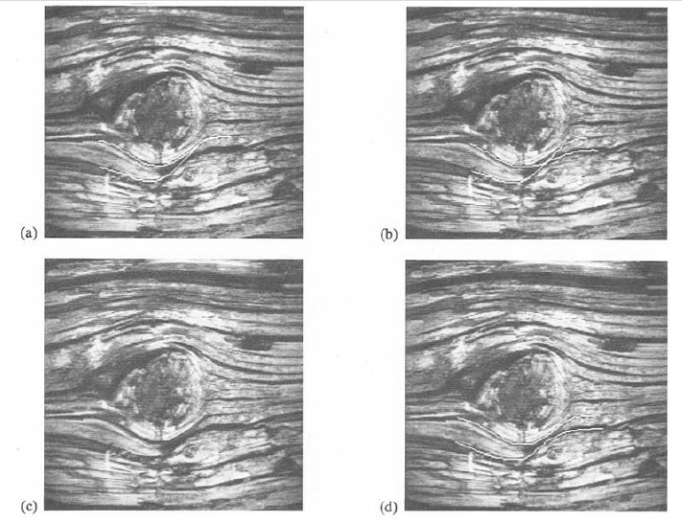
Fig.1 Lower-left: original wood photograph from Brodatz.
Others: Three different local minima for the active contour model.

Slide 5
How good can snakes do?
Can not finding entire salient image contours but rely on other mechanisms to place them near the desired contour.
Once snakes were placed close to an intended contour, its energy minimization will take care of the rest of the way.

Slide 6
Some terms:
Internal spline forces: impose a piecewise smoothness constraint.
Image forces: push the snake toward salient image features, such as lines, edges, and subjective contours.
External constraint forces: putting the snake near the desired local minimum. Can be user interface, automatic attentional mechanisms or high-level interpretations.

Slide 7
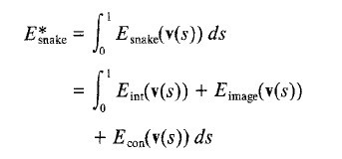
Representing the position of a snake parametrically
by v(s) = (x(s), y(s)), we can write its energy
functional as

Slide 8

2.1 Internal Energy
The internal spline energy can be written

Slide 9
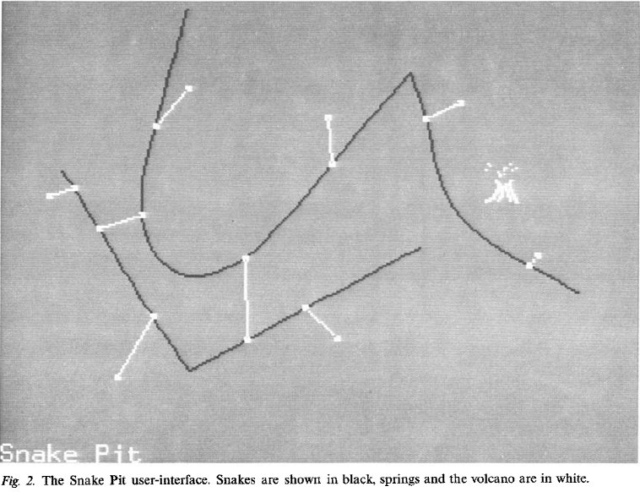
Snake Pit: Specify the particular image feature in a certain picture.

Slide 10
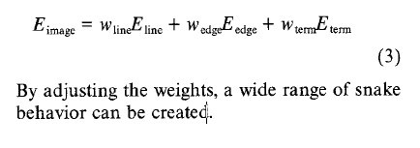
Line Function
Edge Function
Termination Function
Image Forces

Slide 11

Line Function
PS: Used in Fig. 2

Slide 12
Edge Function
snake is attracted to contours with large image gradients.

Slide 13
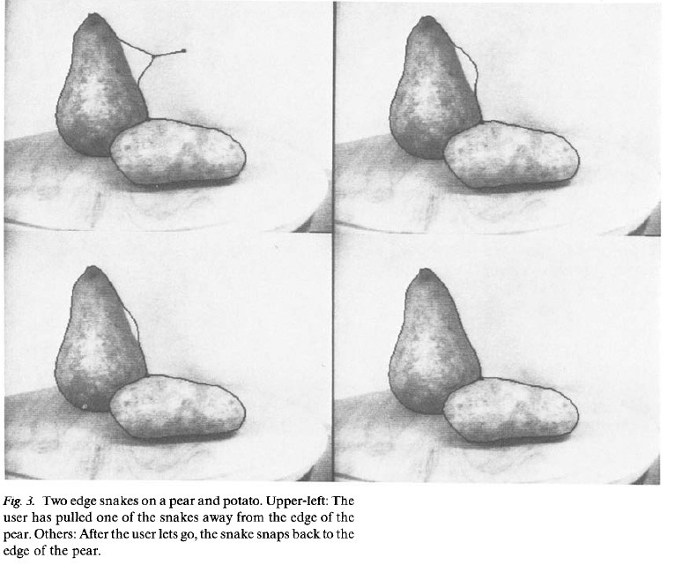

Slide 14
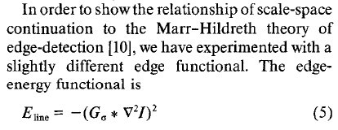
Scale Space Continuation
How to deal with a picture with very blurry energy functional
and reduce the blurring?
Add his energy term to snake means that it is attracted to zero-crossings but still constrained by its own smoothness.

Slide 15
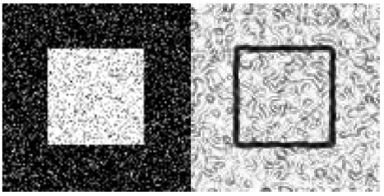

Slide 16
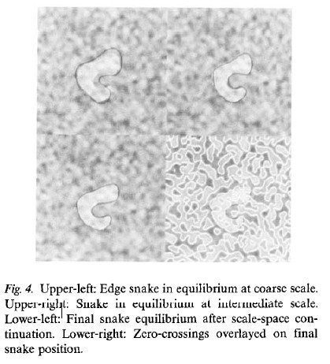

Slide 17
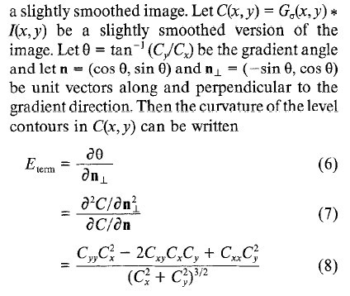
Termination Function
Use the curvature of level lines in a slightly smoothed mage to find terminations of line segments and corners.

Slide 18
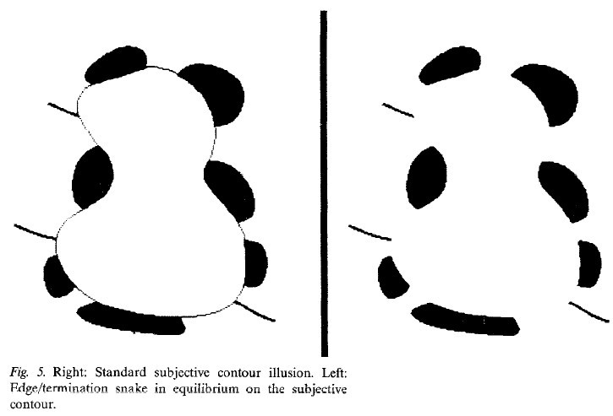
Combining E-edge and E-term, can creat a snake that is attracted to edges or terminations.

Slide 19
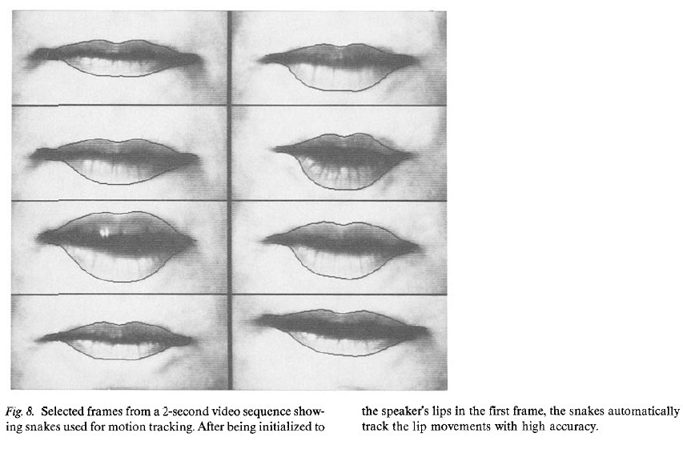

Slide 20
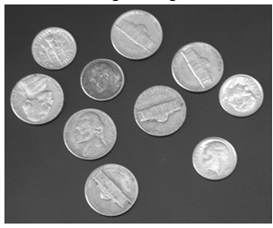



I = imread('coins.png');
Imshow(I) title('Original Image')
bw = activecontour(I,mask,300);

Slide 21

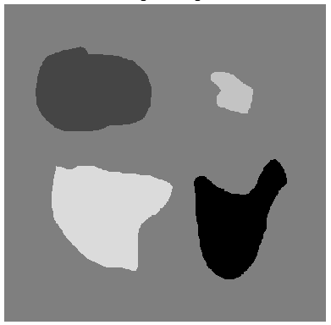
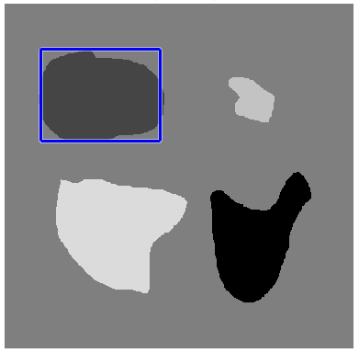
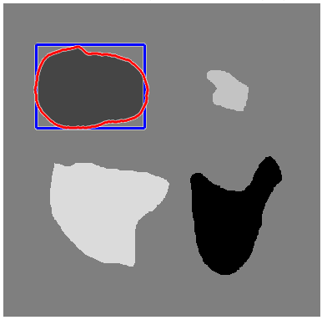


Slide 22
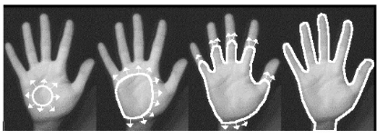
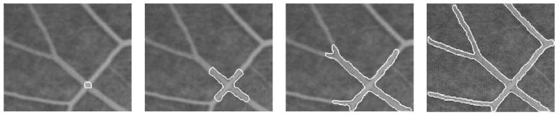

Slide 23
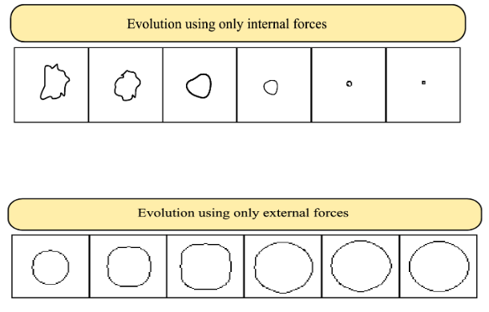

Slide 24
Correlation Filters

Slide 25
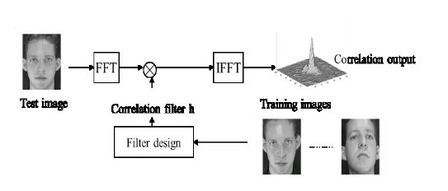

Slide 26
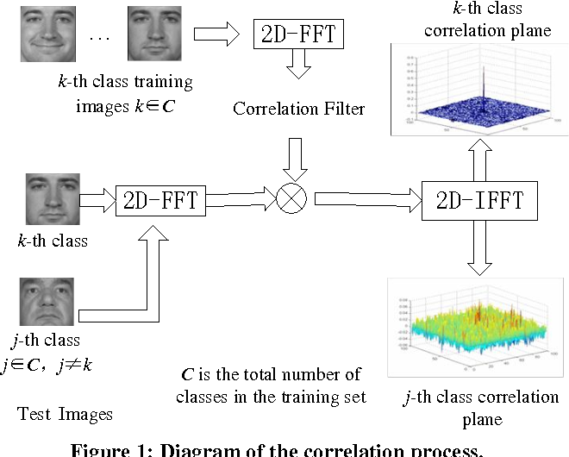

Slide 27
Super Pixel Segmentation

Slide 28
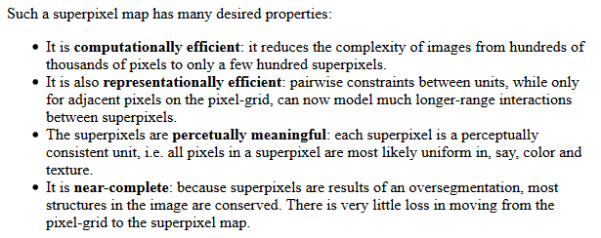

Slide 29
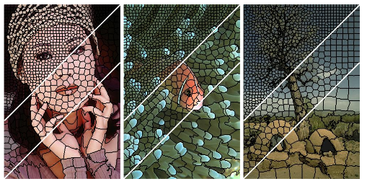
Simple Linear Iterative Clustering SLIC is the popular algorithm

Slide 30
Image Stenography

Slide 31
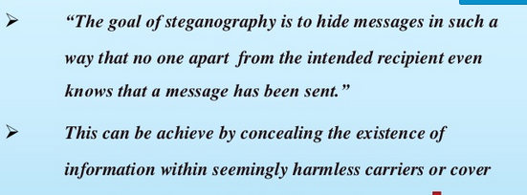

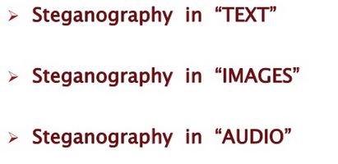

Slide 32
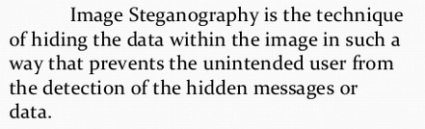
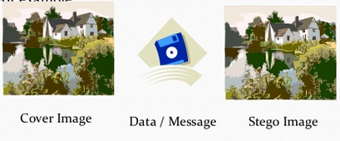
Image Stenography

Slide 33
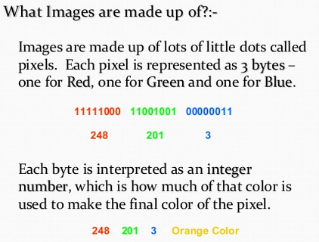
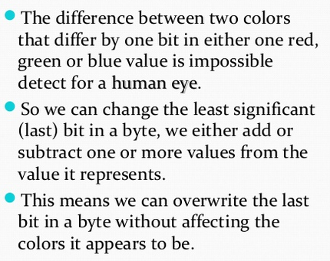

Slide 34
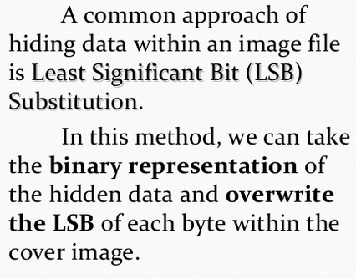
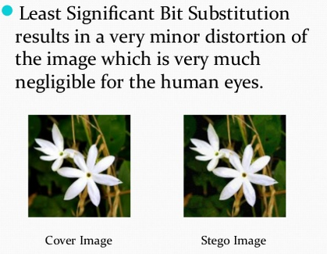



Slide 35
